Slide 1


Slide 2
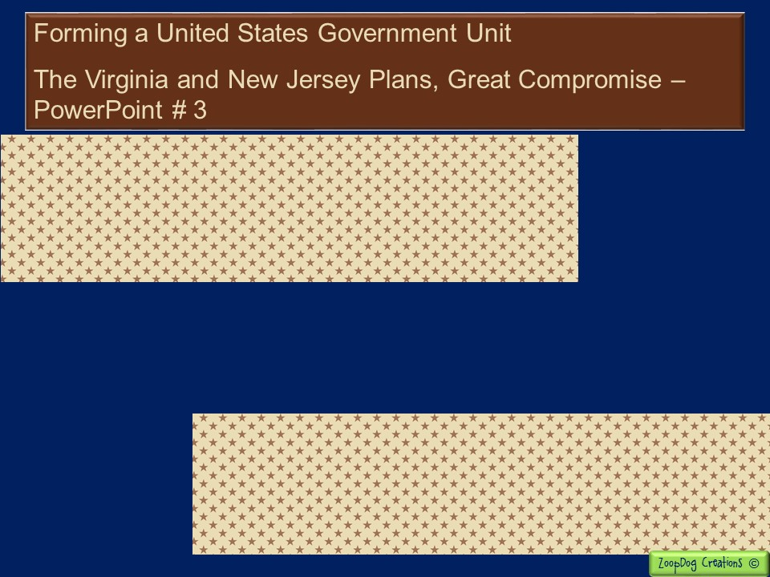
VOCABULARY Unicameral government – James Madison – Virginia Plan – New Jersey Plan – William Paterson – Roger Sherman – Great Compromise –

Slide 3
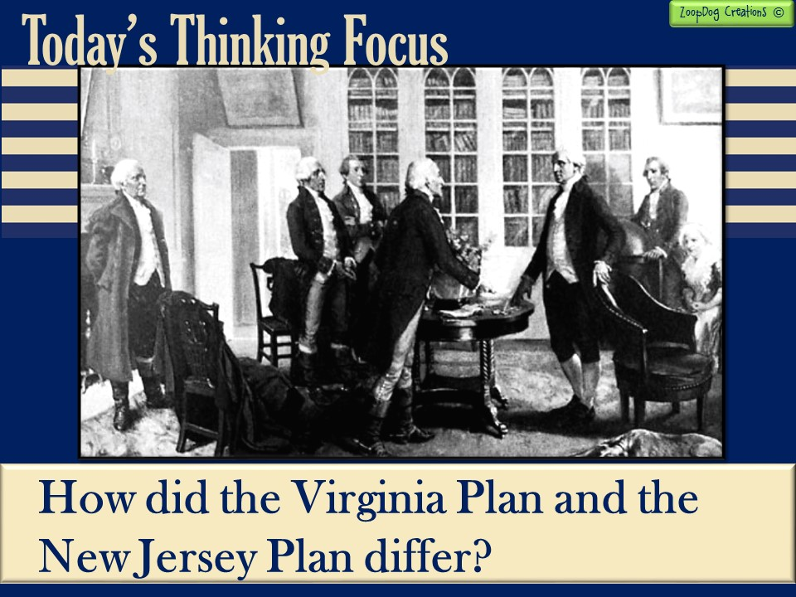

Slide 4

And the story continues . . .
1776, states began forming their own governments and writing their own constitutions.
The Continental Congress began drafting plans for the nation as a whole.
The Continental Congress creates the Articles of Confederation – a weak constitution because it only gave power to the states!
An economic depression hits, states are fighting and the government is too weak to do anything about it!

Slide 5
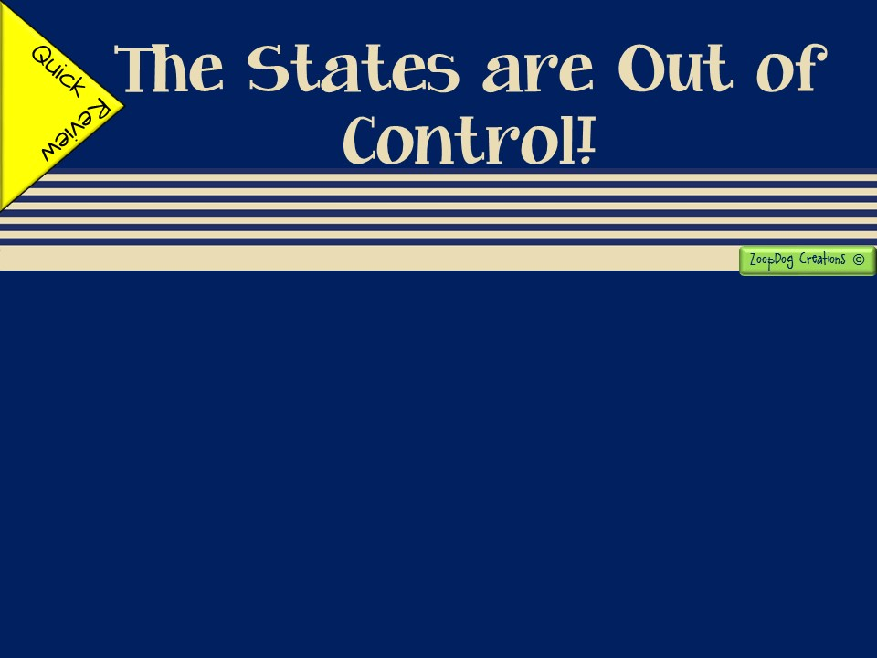
The new government (Articles of Confederation) is too weak while the states are too powerful.
States begin fighting with one another and printing their own money.
States begin increasing taxes on their citizens, especially Massachusetts.
Farmers begin losing their farms and an economic depression hits. The federal government is too weak to do anything about it.
Daniel Shays leads a rebellion of angry farmers. This becomes a “wake up call” for the country to fix the broken government!

Slide 6
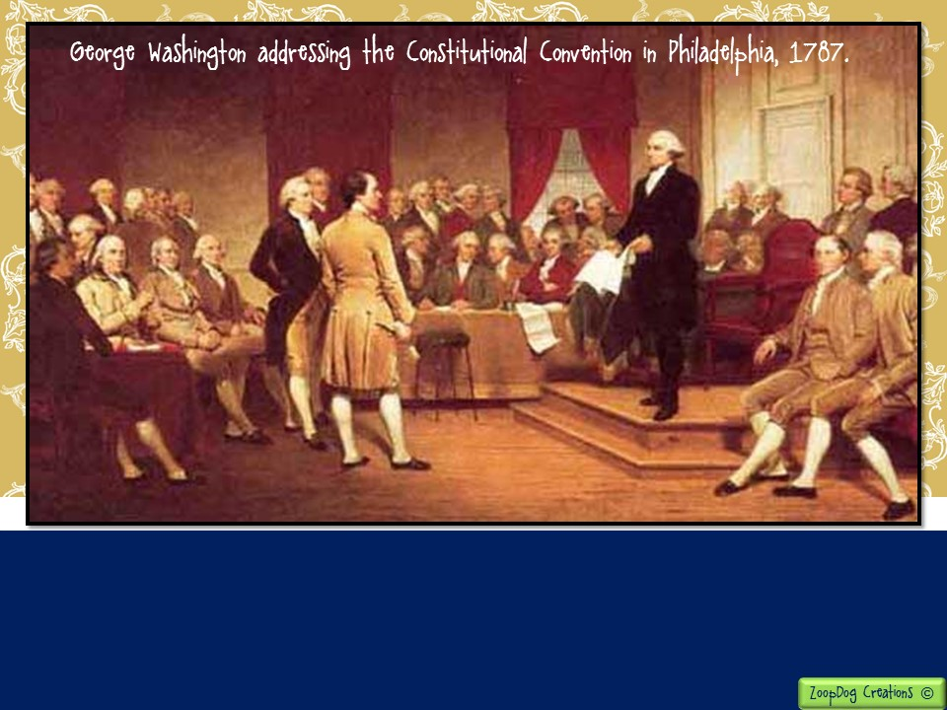
May 25, 1787, (eleven years after the signing of the Declaration of Independence) the Continental Congress met again in Philadelphia to revise the Articles of Confederation.
Every state except Rhode Island sends delegates.

Slide 7
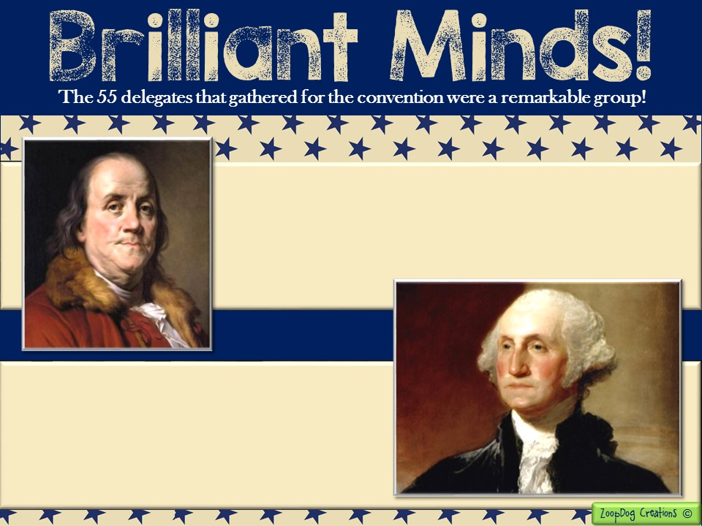
At age 81 Ben Franklin was the oldest delegate! He was wise in the ways of government and human nature.
George Washington was so well respected that the delegates at once elected him president of the Convention.

Slide 8
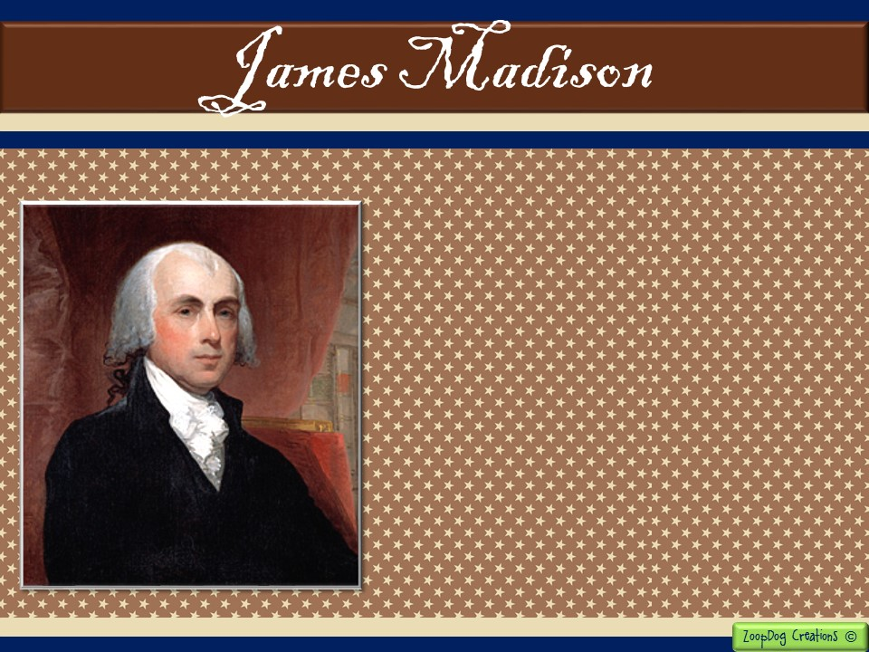
The young James Madison of Virginia was perhaps the best prepared delegate to the Constitutional convention.
For months James Madison had secluded himself on his father’s plantation. There he read many books on history, politics, and commerce (trade).
He arrived in Philadelphia with a case bulging with volumes of research.

Slide 9
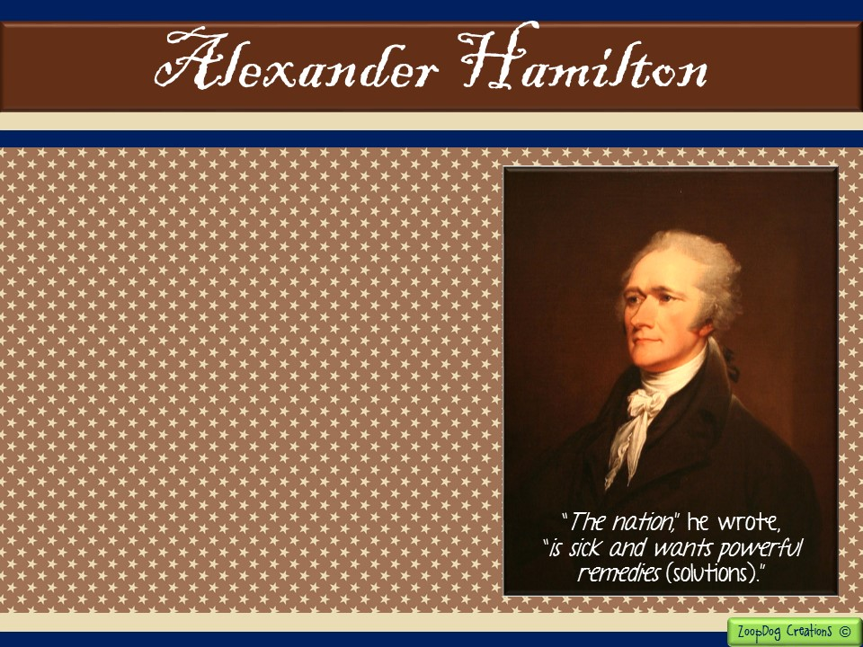
Alexander Hamilton was another young delegate.
During the Revolution, Hamilton served for a time as Washington’s private secretary.
Hamilton despised (hated) the Articles of Confederation!
He believed the government needed a strong national government!

Slide 10
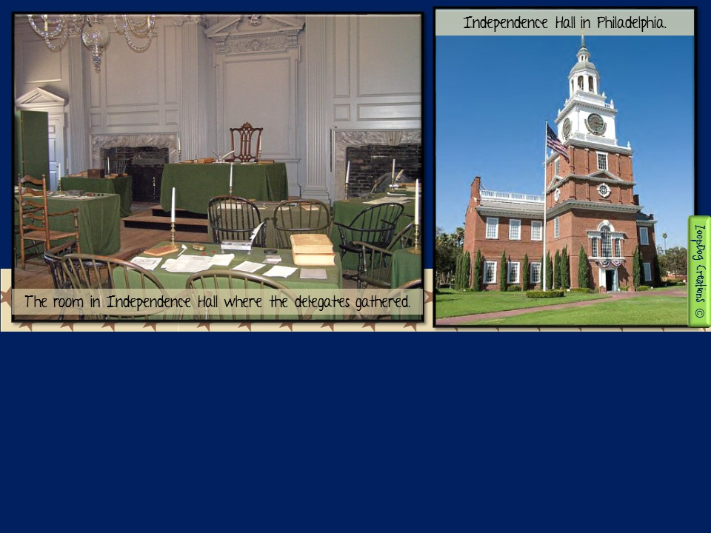
When the convention began, the delegates decided to keep their talks secret. They wanted to speak their minds freely.
Guards stood at the door to ensure secrecy, and the windows were left closed to keep passersby from overhearing the debate.
With the summer heat upon them, the closed windows made the room very hot and stuffy!

Slide 11
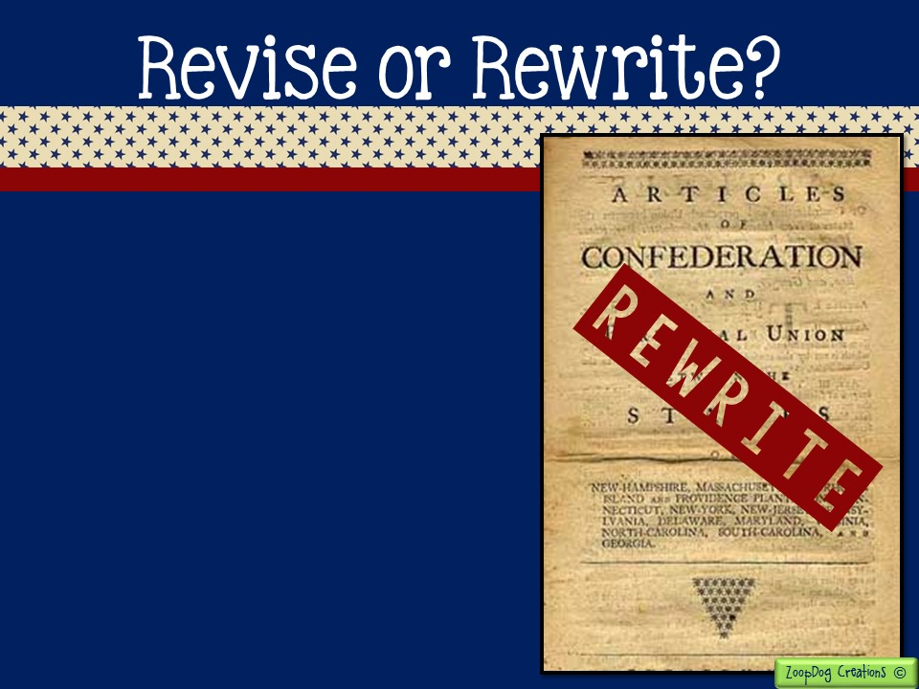
Soon after the meeting began, the delegates decided to do more than revise the Articles of Confederation.
They chose instead to write an entirely new constitution for the nation.
They disagreed (of course!) about what form the national government should take.

Slide 12
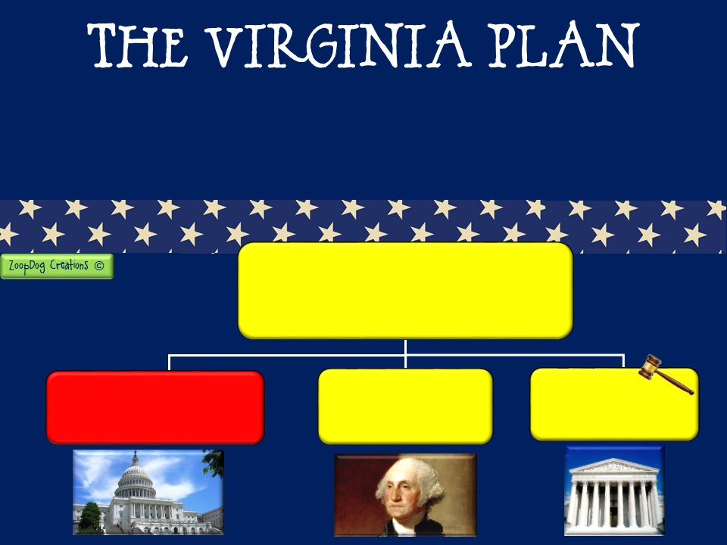
Edmund Randolph and James Madison both from Virginia, proposed a plan for the new government.
The Virginia Plan called for a strong national government with three branches.
Federal Government
Legislative Branch
“Congress”
- Creates and passes the laws -
Executive Branch
- Carries out the laws -
Judicial Branch
- Decides if laws are fair -

Slide 13
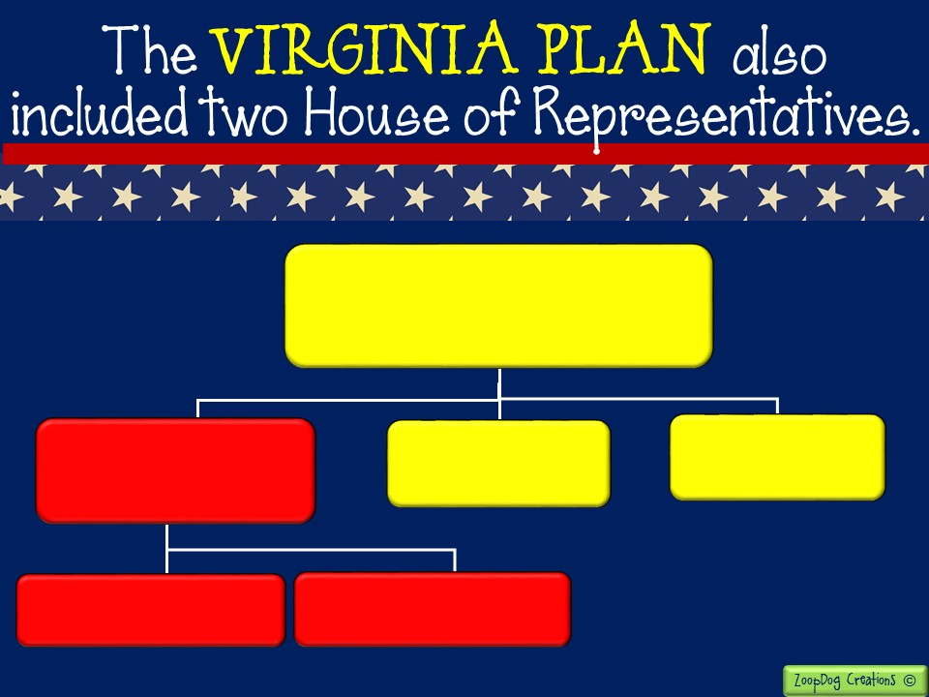
Federal Government
Legislative Branch
“Congress”
- Creates and passes the laws -
Executive Branch
- Carries out the laws -
Judicial Branch
- Decides if laws are fair -
The amount of representatives from each state was based on POPULATION!!
House of Representatives #1
House of Representatives #2

Slide 14

RHODE ISLAND
Small population =
Few representatives =
Little power in government
VIRGINIA
Large population =
Many representatives =
BIG power in government

Slide 15

QUESTION: Why would only the most populated states like the Virginia Plan?
QUESTION: If the Articles of Confederation gave all the power to the states, how is the Virginia Plan different?

Slide 16
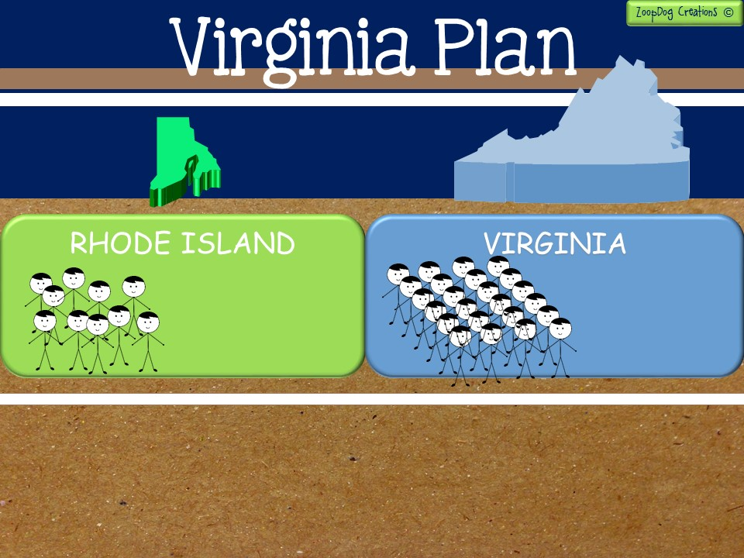
Small population.
Less voting power in Congress.
=
Large population.
More voting power in Congress.
=
Small states objected strongly to the Virginia Plan. They feared that the large states could easily outvote them in Congress.
In response, supporters of the Virginia Plan said it was only fair for a state with more people to have more representatives.

Slide 17

After two weeks of debate, William Paterson of New Jersey presented a plan that had the support of the small states.
Like the Virginia Plan, the New Jersey Plan called for 3 branches of government, but it called for only one house.
Each state regardless of their population, would have one vote in the legislature!

Slide 18
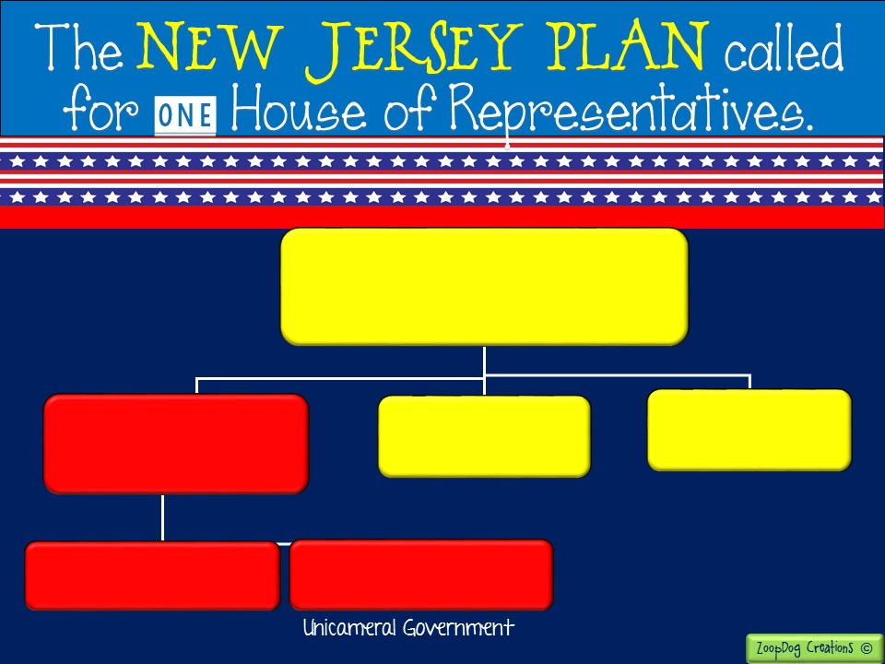
Federal Government
Legislative Branch
“Congress”
- Creates and passes the laws -
Executive Branch
- Carries out the laws -
Judicial Branch
- Decides if laws are fair -
House of Representatives #2
Every state, regardless of population, would receive two representatives.
House of Representatives #1

Slide 19
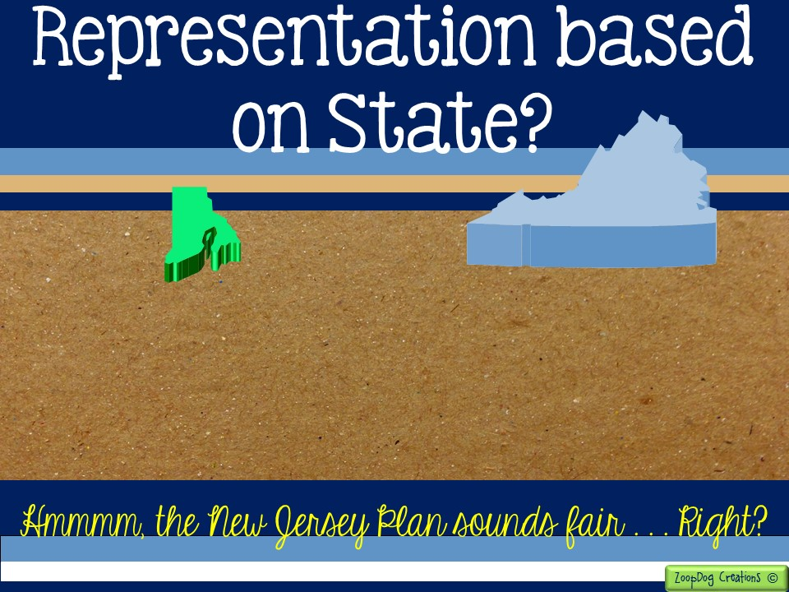
RHODE ISLAND
Small population =
Two representatives =
ONE VOTE in government
VIRGINIA
Large population =
Two representatives =
ONE VOTE in government

Slide 20
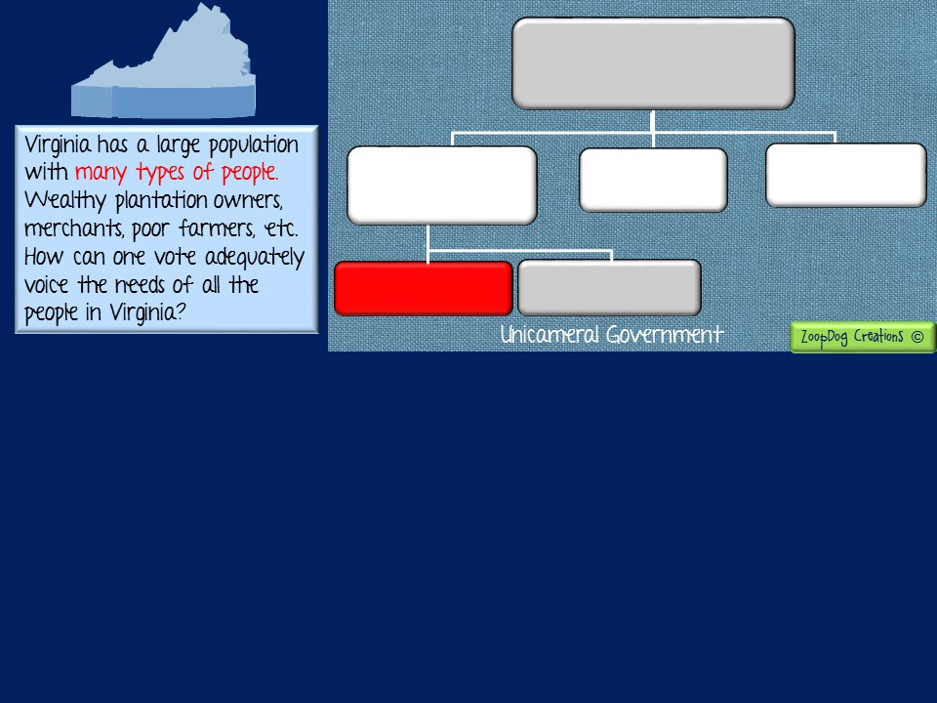
Federal Government
Legislative Branch
“Congress”
- Creates and passes the laws -
Executive Branch
- Carries out the laws -
Judicial Branch
- Decides if laws are fair -
House of Representatives
House of Representatives
The New Jersey Plan sounds fair with each state given ONE vote. Right? But a unicameral system (one house) limits important sectors of society that may not be given a voice in their government.
In a democratic government the representatives must speak for the people who elected them. Representatives must give the people a VOICE!
Does the New Jersey Plan truly represent the voice of the people if every state only has one vote?

Slide 21
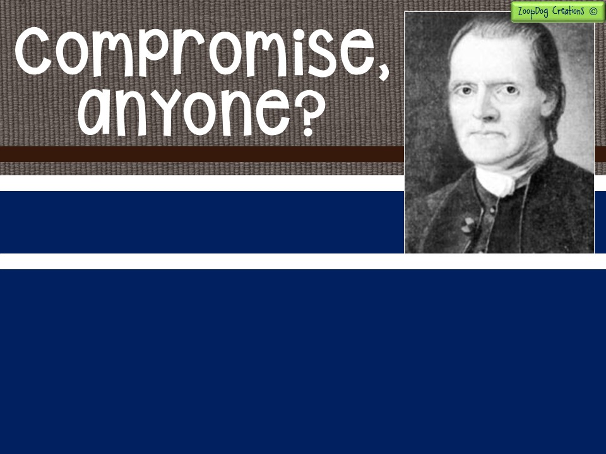
For awhile no agreement could be reached and tempers flared (remember they are sitting in a hot room with wigs and tights on!).
It seemed the convention would fall apart if the founding fathers didn’t find a plan they all could agreed upon!
Finally Roger Sherman of Connecticut worked out a compromise that he hoped would satisfy both large and small states!!

Slide 22

Sherman’s proposal called for a two-house legislature.
Lower house, known as the House of Representatives, would have members based according to each states population.
Upper house, known as the Senate, would have two members from every state.
On July 16, the delegates narrowly approved Sherman’s plan. It became known as the Great Compromise!

Slide 23
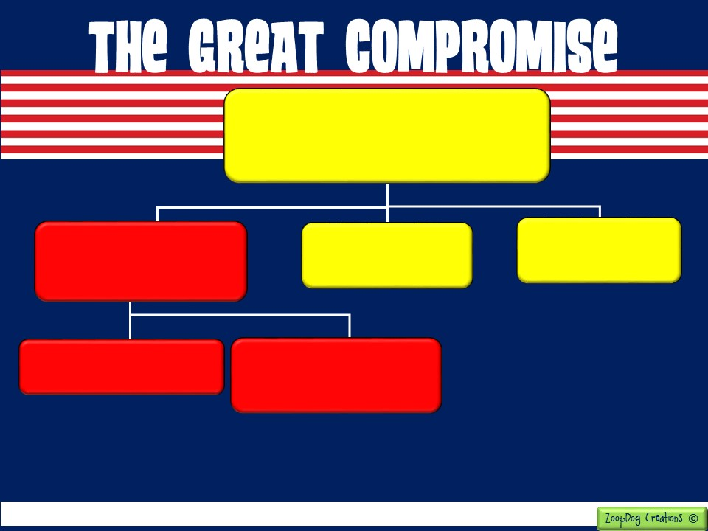
Federal Government
Legislative Branch
“Congress”
- Creates and passes the laws -
Executive Branch
- Carries out the laws -
Judicial Branch
- Decides if laws are fair -
Upper House
“The Senate”
Lower House
“House of Representatives”
Each state, no matter what the population, would receive two representatives.
House of Representatives receives its members based on the population of each state. Larger states have more representatives.

Slide 24
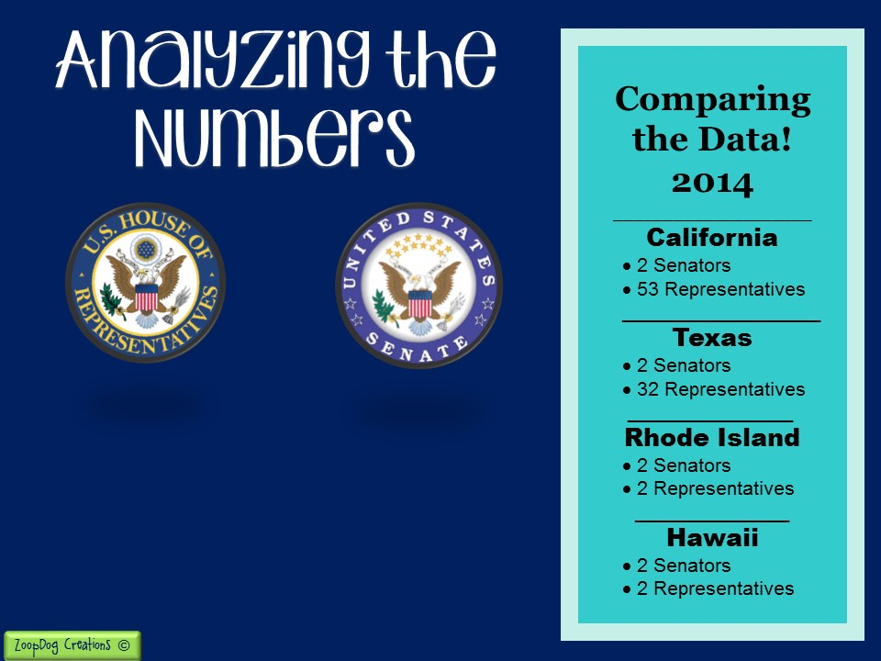
There are currently 435 representatives, a number fixed by law since 1911. The most populous state, California, currently has 53 representatives.
There are 100 Senators in the Senate
(50 states x 2 representatives = 100). The number of Senators per state remains at two and the total number only changes when a new state is admitted into the union.

Slide 25


Slide 26


Slide 27


